Slide 1
Intune Graph API Automation
Timmy Andersson
www.timmyit.com, tan@ctglobalservices.com, Sr. Consultant
CTGlobal
Sandy Zeng
Blog: www.scconfigmgr.com Blog: www.thesccm.com
System Architect, Valtori

Slide 2
Sandy Zeng
Timmy Andersson
@Sandy_tsang
@timmyitdotcom
Enterprise Mobility MVP
MCSE, MCSA
+10 Years
+10 Years
Food
Golf, podcasts and documentaries

Slide 3
AGENDA
What is Microsoft Graph API
And how does Intune consume it?
Automation Journey

Slide 4
WHAT IS Microsoft GRAPH API
And how does Intune consume it….

Slide 5
Microsoft GRAPH
HTTPS://GRAPH.MICROSOFT.COM/
Insights and relationships from Office graphs
A unified REST API endpoint
Single resource that proxies multiple Microsoft services
Allows for easy traversal of objects and relationships
Access to data and intelligence
Eliminates the need to discover endpoints
Only one OAuth access token needed
Available as a public API

Slide 6







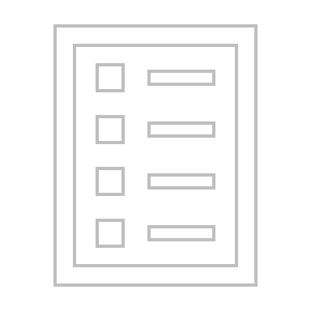
Microsoft Graph
CONVERSATIONS
ACTIVITY
CONTENT
INSIGHTS
ME
TRENDING
ORGANIZATION
GROUPS
CHATS
DOCUMENTS
REPORTS
EVENTS
DEVICES
SHARED
CONTACTS
EMAIL
PEOPLE
TASKS
COLLABORATION

Slide 7







Intune in Azure
IT Pro Experience - https://portal.azure.com
Microsoft Intune
Azure Active Directory
MANAGE
MANAGE
Device Compliance
Device Configuration
Mobile Apps
Users
Groups
Microsoft Graph API (SDK) https://graph.microsoft.com
Service Endpoints
Policy Provider
Application Provider
Groups Provider

Slide 8
Automation Journey

Slide 9
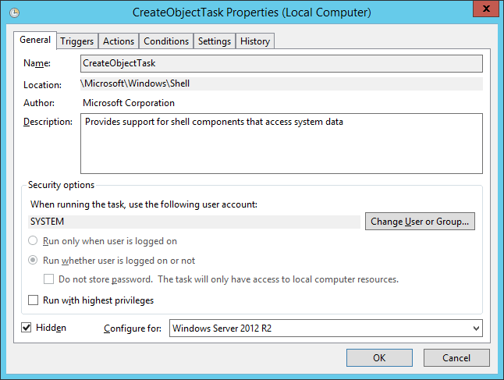
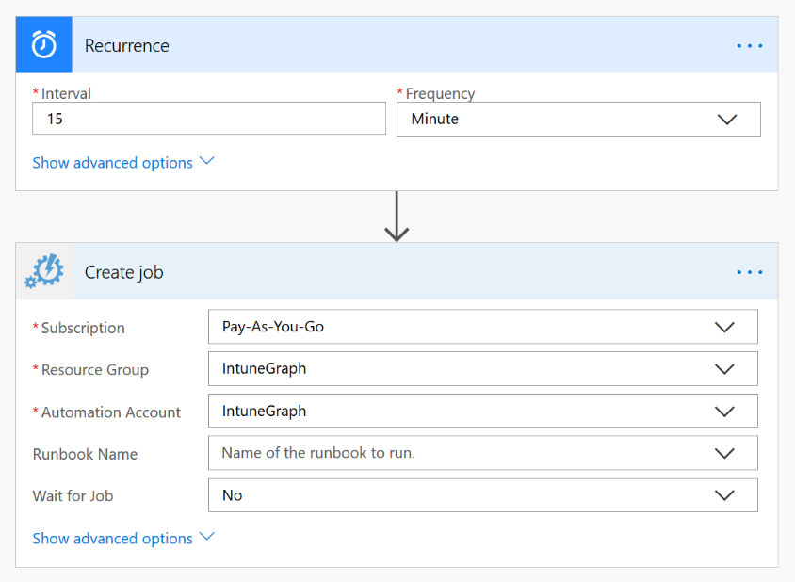
Automation Journey
Azure Automation delivers a cloud-based automation and configuration service
Traditional – On premise
Modern – Azure Automation

Slide 10
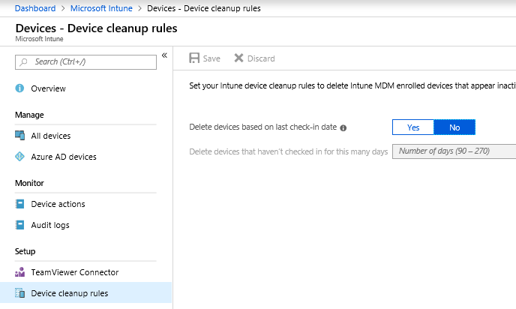
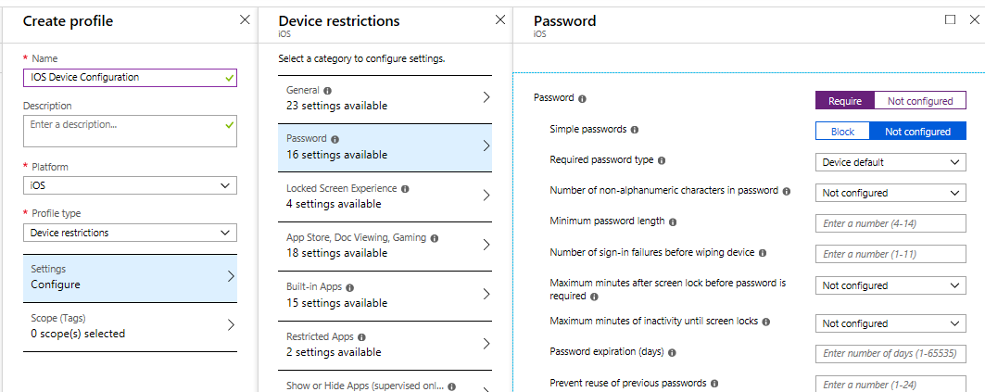
AUTOMATION Rules in the Intune UI Today
Device clean-up rules
If {device},
meets {last check-in date >90};
perform action {retire devices}
Device configuration policy
If {device},
meets {membership in SG};
perform action {apply profile settings}

Slide 11
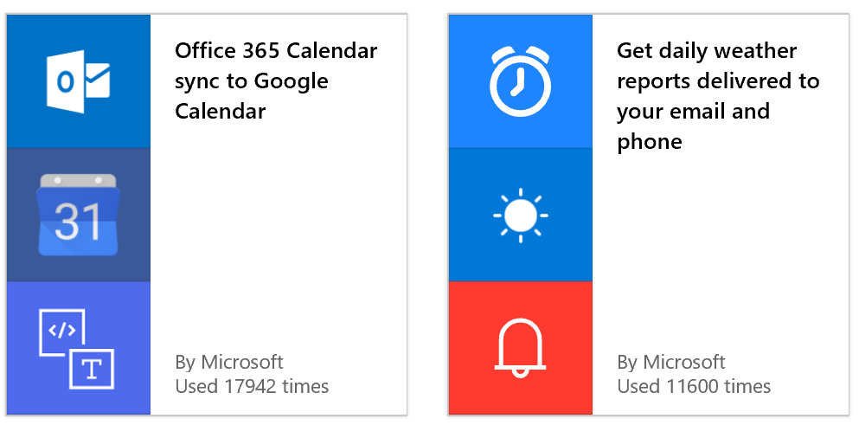
High Level Overview
Intune UI
Centralized automation including:
Device Clean-Up Rules
Non-Compliance Rules e.g. Email, remote lock
Other Automation
Examples include:
PowerShell Scripts – GitHub Samples or SDK Module
Azure Automation / Flow / Logic Apps

Slide 12
Automation Scenarios
The Art of the Possible

Slide 13
Automation Scenarios
The Art of the Possible…
Azure Automation
Intune Powershell SDK Module now available

Slide 14





Intune in Azure – Azure Automation
You can use Azure Automation i.e. Runbooks to complete Graph automation
Create PowerShell Runbook
PowerShell Runbook sends data to Microsoft Flow
1
6
Automation
Accounts
Microsoft Flow
PowerShell Runbook
Data returned from Graph to the Runbook
2
5
Use Microsoft Graph to get data
Microsoft Graph requests data from Intune
3
4
Intune returns data to Microsoft Graph
Microsoft Graph
Microsoft Intune

Slide 15
Using the Intune powershell SDK in Azure Automation
DEMO
Notes:
https://timmyit.com/2019/08/05/schedule-custom-notifications-with-azure-automation-and-the-intune-powershell-sdk/
https://timmyit.com/2019/08/02/import-the-intune-powershell-sdk-module-in-azure-automation/

Slide 16
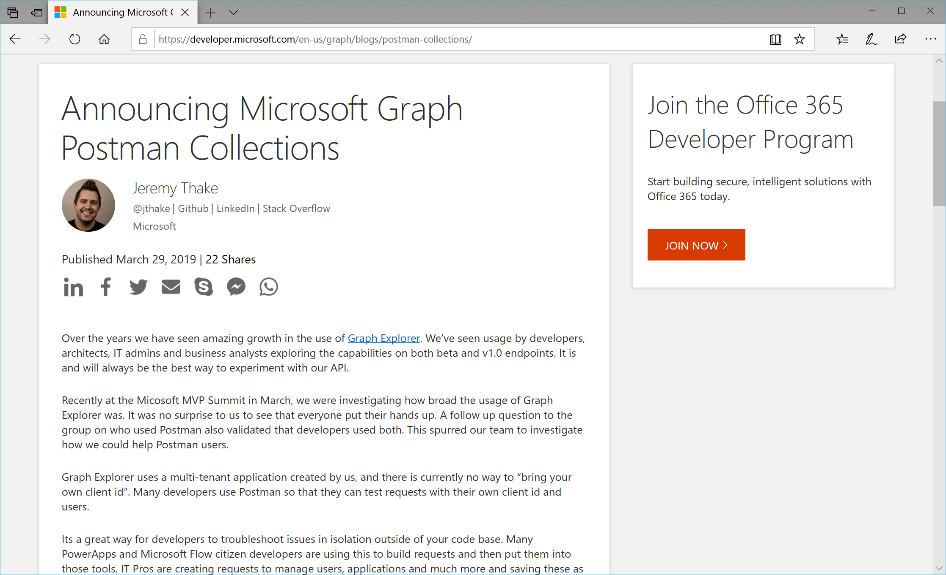
30 days blog series on Microsoft graph
https://developer.microsoft.com/en-us/powerpoint/blogs/announcing-30-days-of-microsoft-graph-blog-series/
Notes:
https://developer.microsoft.com/en-us/powerpoint/blogs/announcing-30-days-of-microsoft-graph-blog-series/

Slide 17
Multi tenant automation with graph api
DEMO

Slide 18
- Create Azure Application with application permission
Create application secret
Admin consent to multiple tenant
- Use application ID and secret to authenticate to multiple tenants
https://github.com/sandytsang/Presentations/tree/master/2019/MMSJazz/03.IntuneGraphAutomation

Slide 19
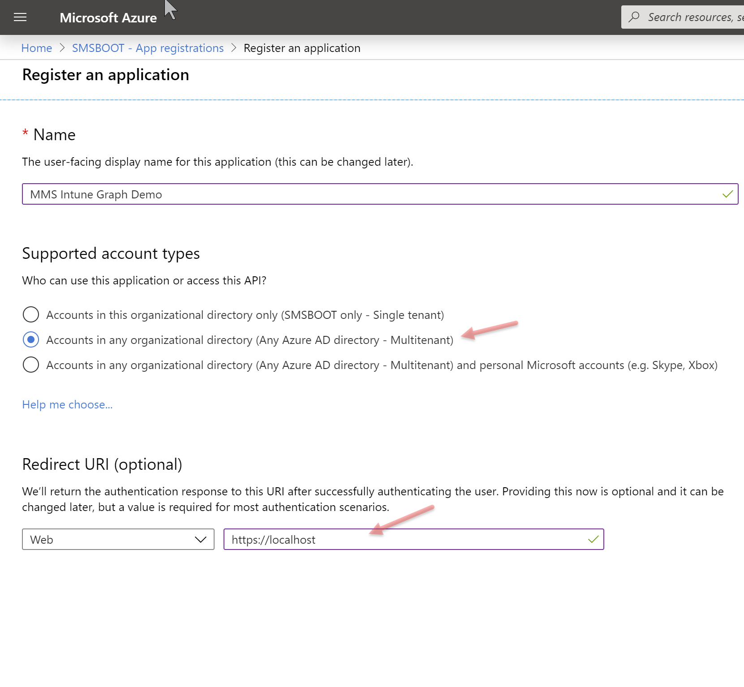
Create Azure Application

Slide 20
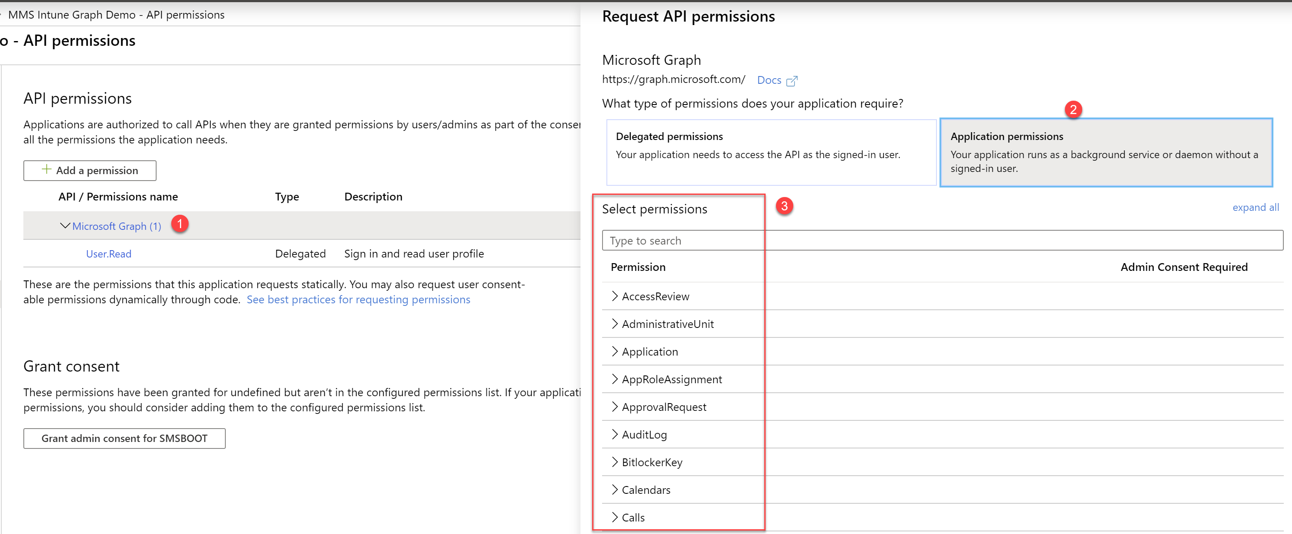
Add application permissions

Slide 21
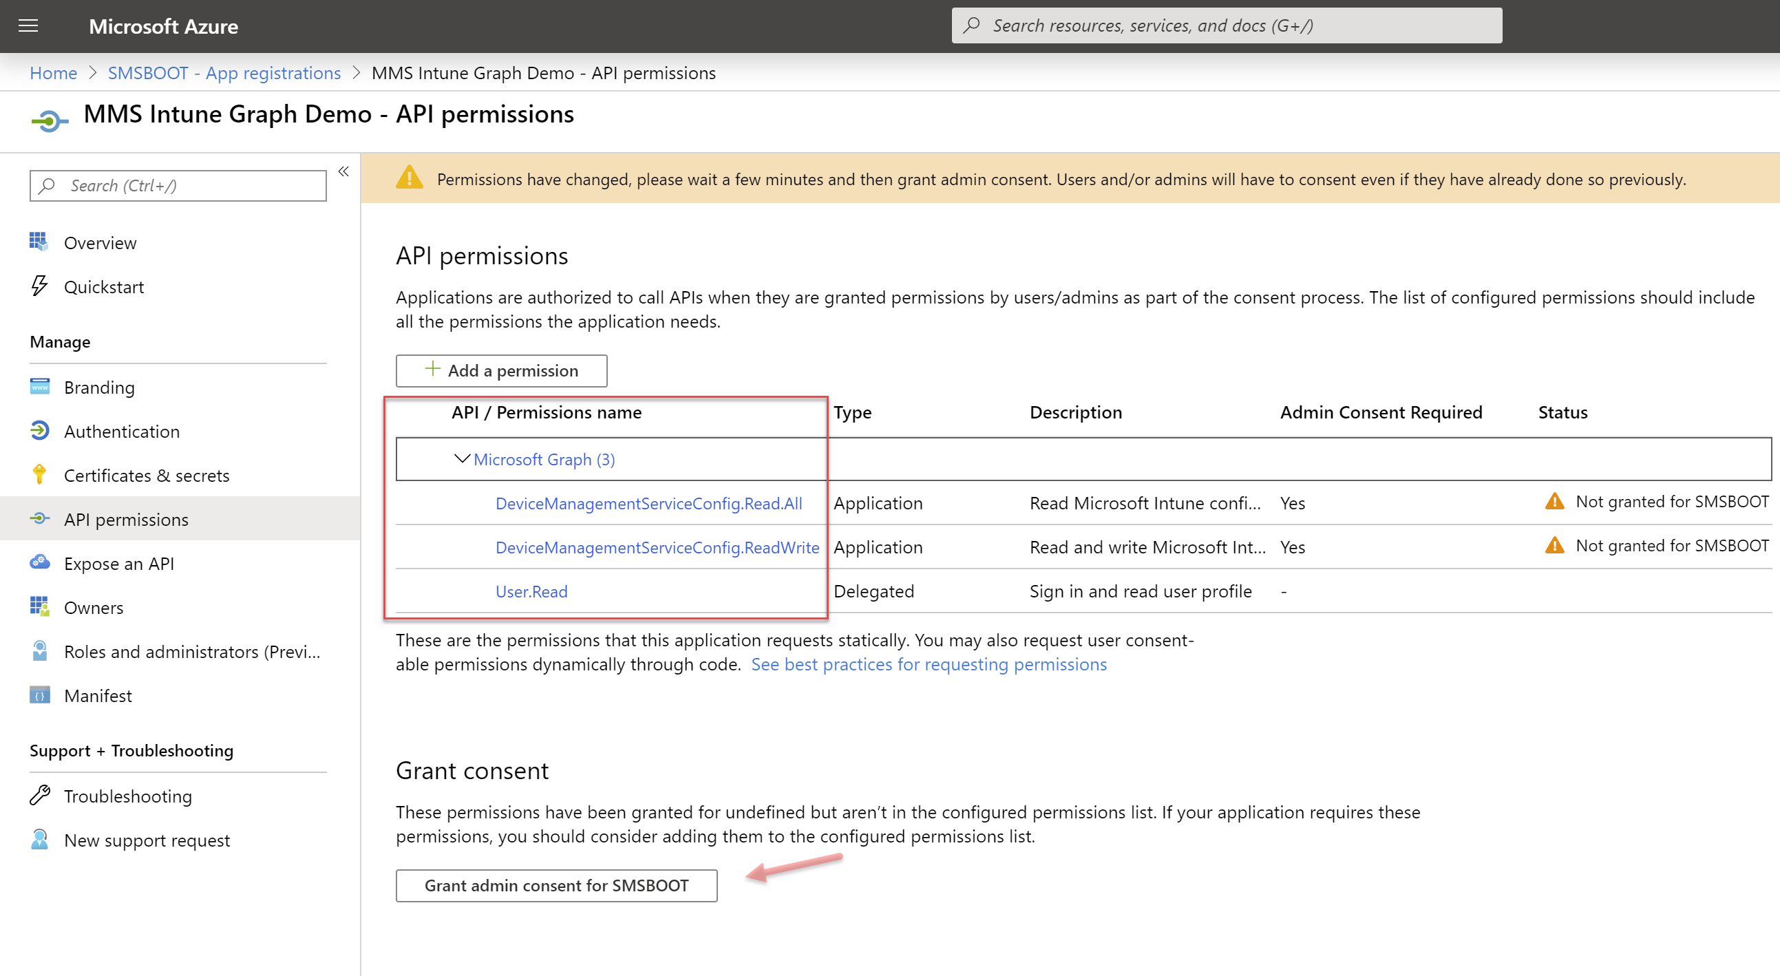
Grant admin consent

Slide 22
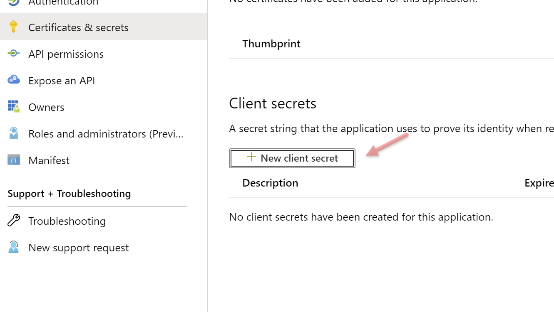
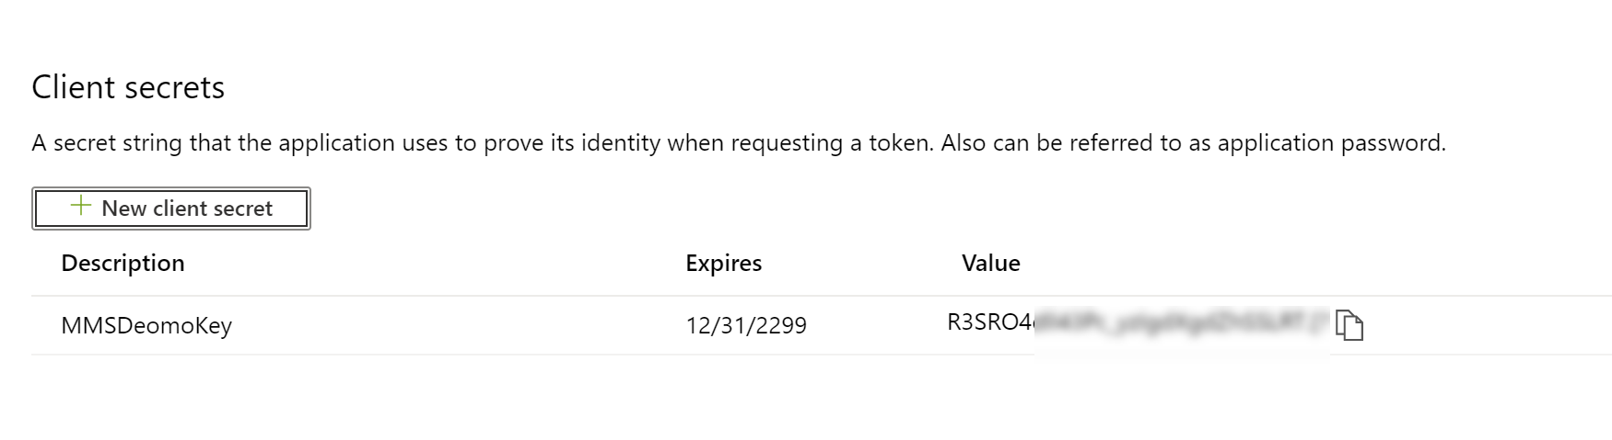
Create secrets
Remember copy secret value to notepad

Slide 23
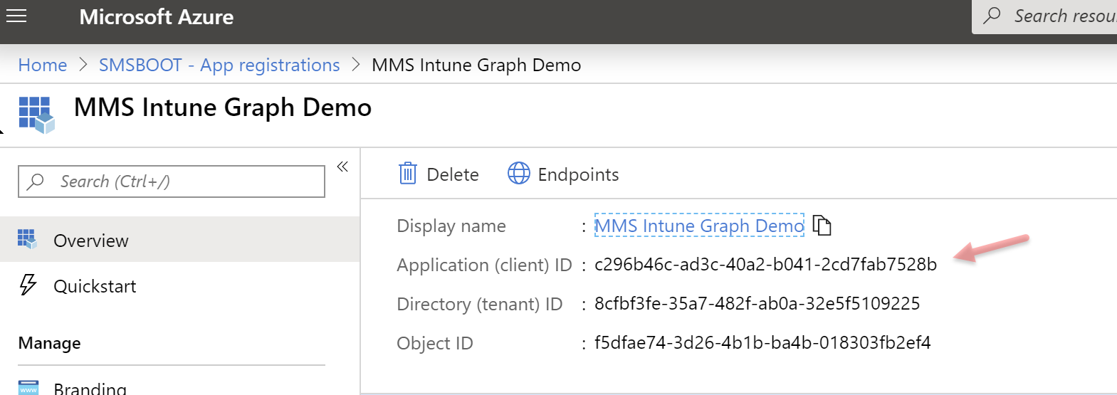
Admin consent to multiple tenant
For example grant access to mvp24.onmicrosoft.com tenant>
https://login.microsoftonline.com/mvp24.onmicrosoft.com/adminconsent?client_id=c296b46c-ad3c-40a2-b041-2cd7fab7528b&state=1234&redirect_uri=https://localhost

Slide 24
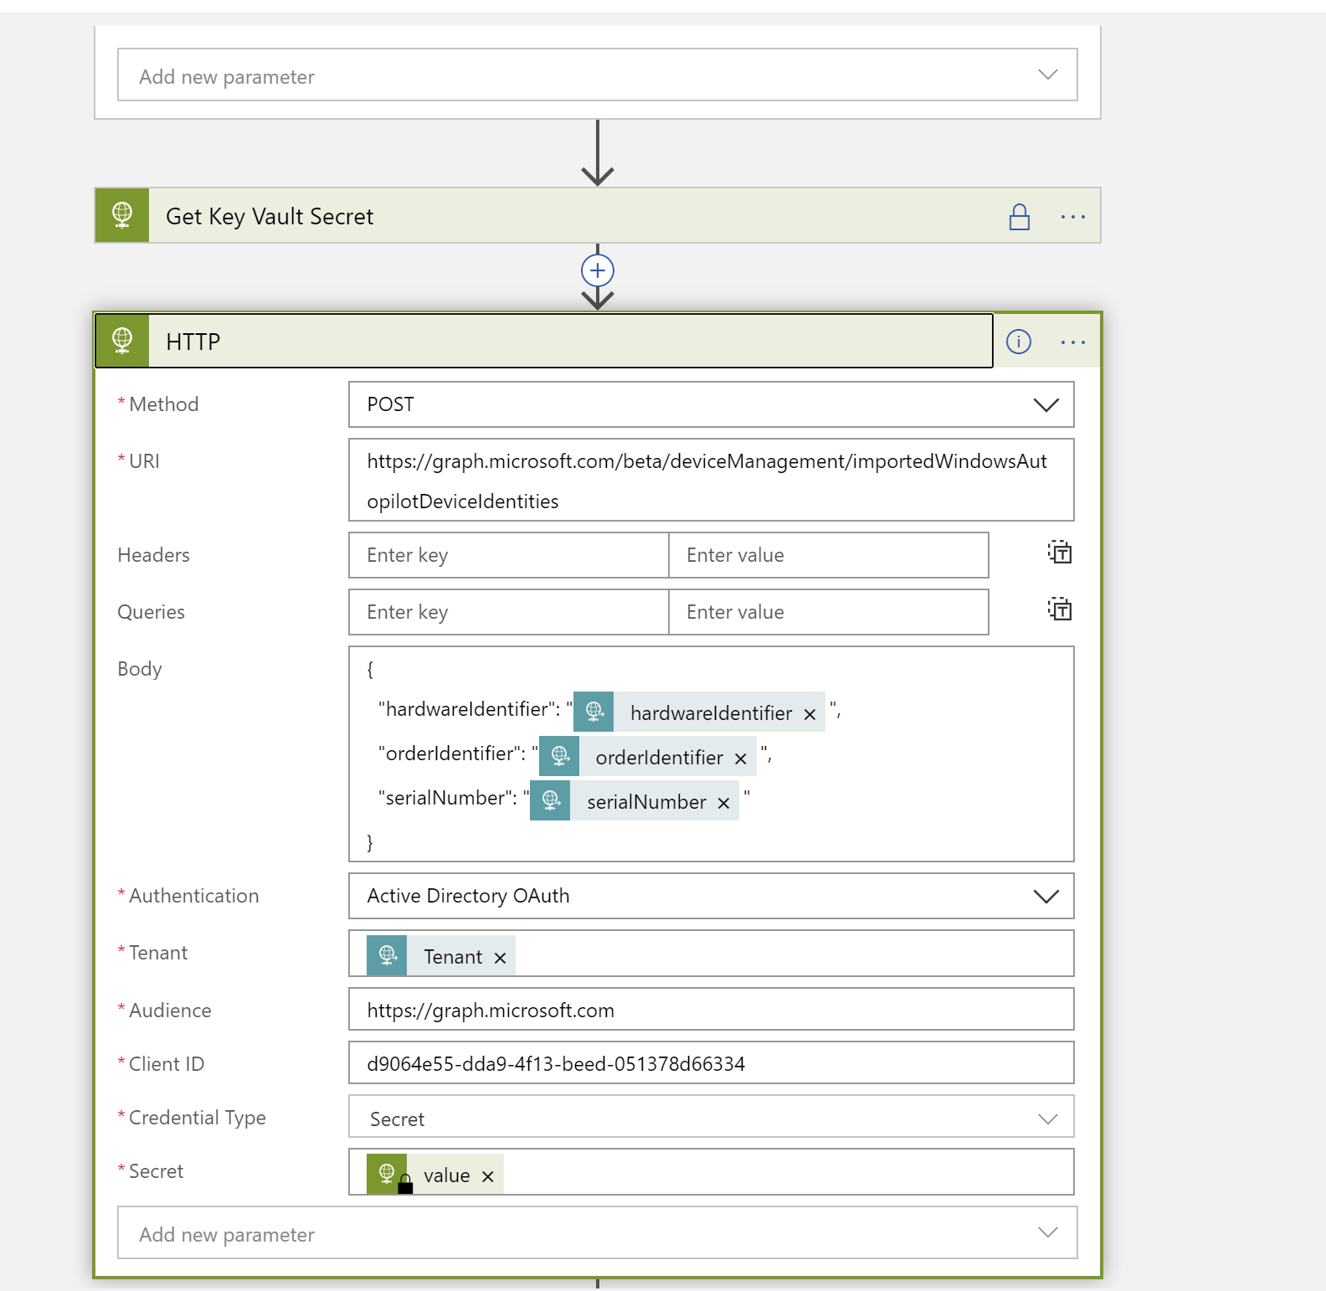
Run logic app import autopilot
Blog post is coming up

Slide 25
Takeways
What is Microsoft Graph API
And how does Intune consume it?
Automation Journey

Slide 26
Useful links
https://developer.microsoft.com/en-us/powerpoint/blogs/announcing-30-days-of-microsoft-graph-blog-series/
https://timmyit.com/2019/08/02/import-the-intune-powershell-sdk-module-in-azure-automation/
https://docs.microsoft.com/en-us/graph/auth-register-app-v2
https://docs.microsoft.com/en-us/graph/auth-v2-service
https://www.spcnl.nl/retrieve-azure-key-vault-secrets-from-logic-apps-using-managed-identity/

Slide 27

Share your ideas
Share your voice / ideas!
http://microsoftintune.uservoice.com/
Notes:
Both

Slide 28
Join the online community
Ask questions and discuss over at
http://www.reddit.com/r/Intune
Facebook group - Microsoft Enterprise Mobility +Security
Notes:
Both

Slide 30
Section Header
This is the next section

Slide 31
Title
Line1
Bullet Level 1
Bullet Level 2
Bullet Level 3

Slide 32
Title
Code

Slide 33
Text Only with Border
Level 1
Level 2
Level 3

Slide 34
Text Only (Dark)
Level 1
Level 2
Level 3

Slide 35
Title
Text 1
Level 1
Level 2
Level 3
Text 2
Level 1
Level 2
Level 3

Slide 36
Title
Section 1
Section 2
Text
Level 1
Level 2
Level 3
Text
Level 1
Level 2
Level 3

Slide 37
Demo Title

Slide 38





























Slide 39






























Slide 40




























Slide 41

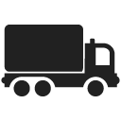


























Slide 42




























Slide 43




























Slide 44




























Slide 45























Slide 46
















